Slide 1
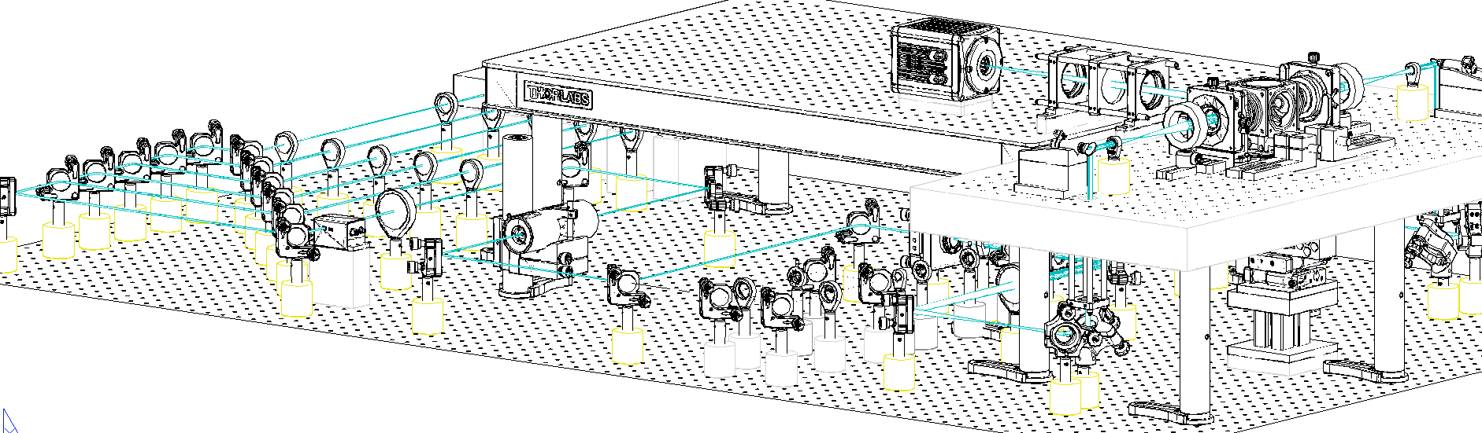
A
561 nm
515 nm
491 nm
445 nm
405 nm
Detection
Olympus
25×, 1.0NA
WD: 8mm
v
f 200
galvo
Camera
filter
f 200
f 50
f 140
f 350
f 100
v
f 200
Axicon
f 50
D
LP 552
PBS
LP 503
I
Nikon CFI LU Plan Fluor EPI 10×, NA 0.30, WD 17.5 mm
LP 466
I
f 350
f 150
LP 427
f 100
f 50
f 150
LM
f 50
C
AOTF
f 100
f 250
galvo
I1
I2
f 50
f 150
A
B
f 200
B

Slide 2
A
561 nm
515 nm
491 nm
445 nm
405 nm
Detection
Olympus
25×, 1.0NA
WD: 8mm
v
f 200
galvo
Camera
filter
f 200
f 50
f 140
f 350
f 100
v
f 200
Axicon
f 50
D
LP 552
PBS
LP 503
I
Nikon CFI LU Plan Fluor EPI 10×, NA 0.30, WD 17.5 mm
LP 466
I
f 350
f 150
LP 427
f 100
f 50
f 150
LM
f 50
C
AOTF
f 100
f 250
galvo
I1
I2
f 50
f 150
A
B
f 200
B
Motor
stages
Periscope

Slide 3
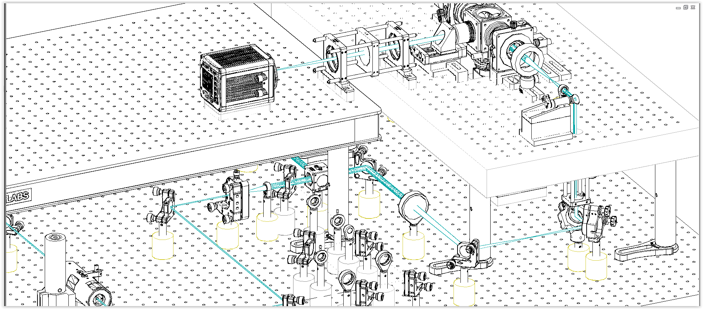
A
561 nm
515 nm
491 nm
445 nm
405 nm
Detection
Olympus
25×, 1.0NA
WD: 8mm
v
f 200
galvo
Camera
filter
f 200
f 50
f 140
f 350
f 100
v
f 200
Axicon
f 50
D
LP 552
PBS
LP 503
I
Nikon CFI LU Plan Fluor EPI 10×, NA 0.30, WD 17.5 mm
LP 466
I
f 350
f 150
LP 427
f 100
f 50
f 150
LM
f 50
C
AOTF
f 100
f 250
galvo
I1
I2
f 50
f 150
A
B
f 200
B

Slide 4
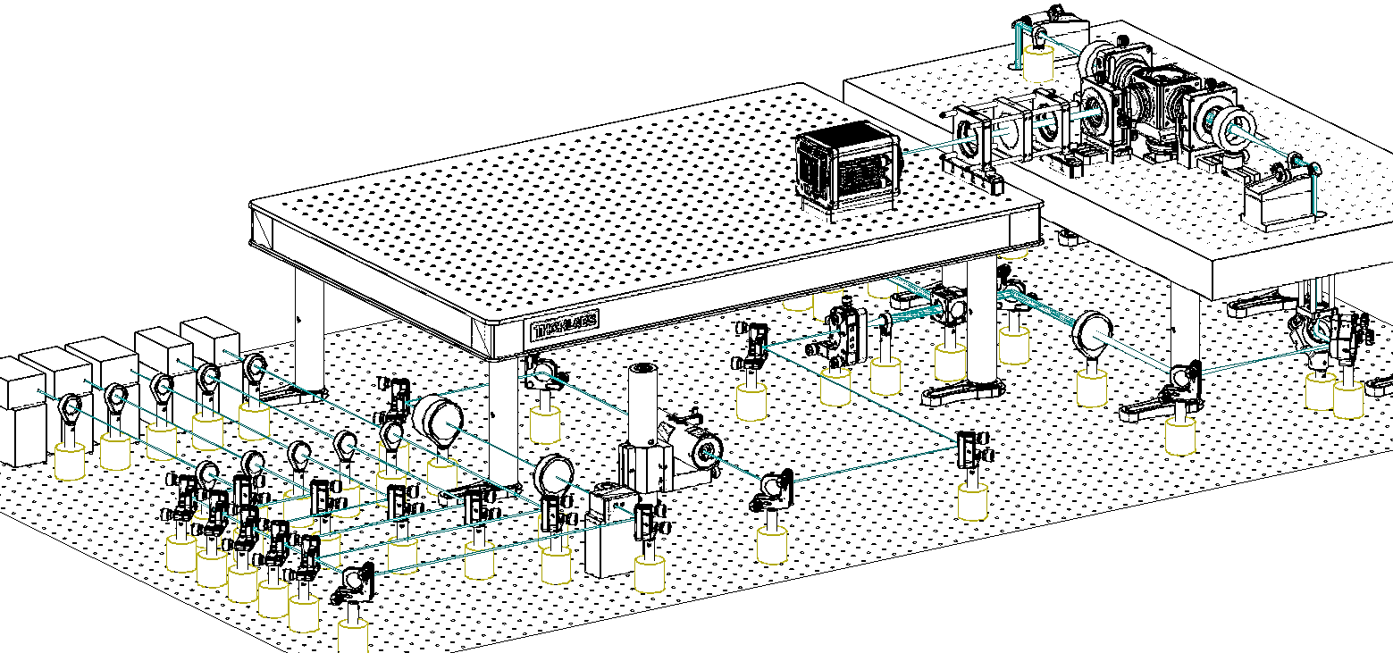

Slide 6
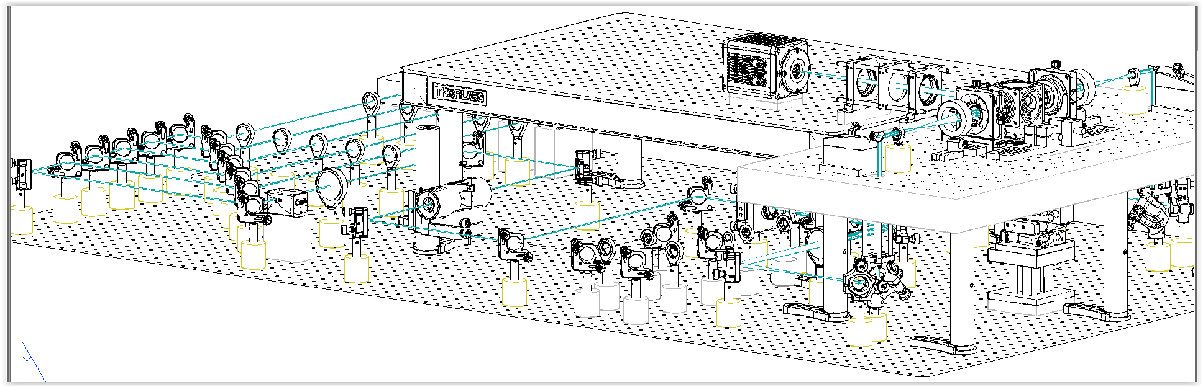

Slide 7
Olympus XLSLPLN25XGMP
25×, 1.0NA
WD: 8mm
Camera
f 200

Slide 8
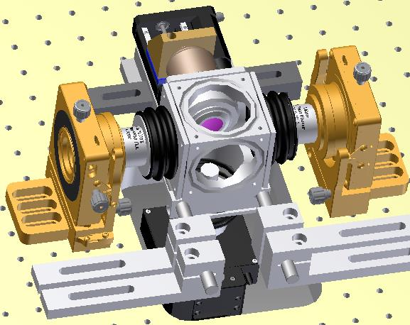
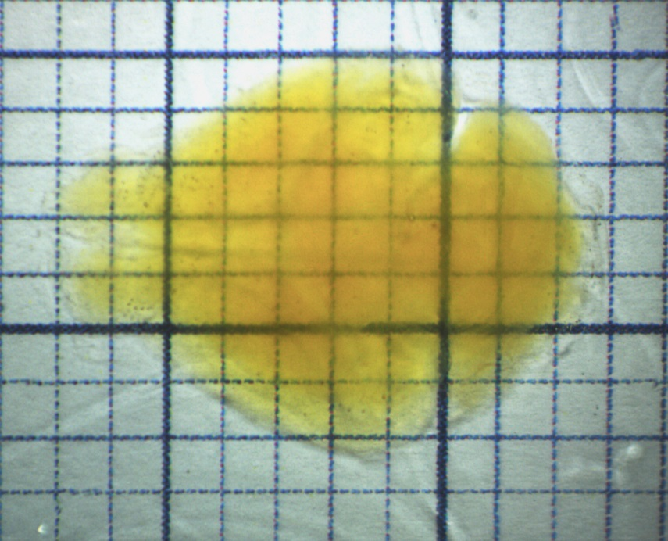
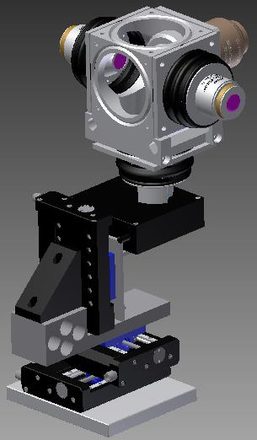
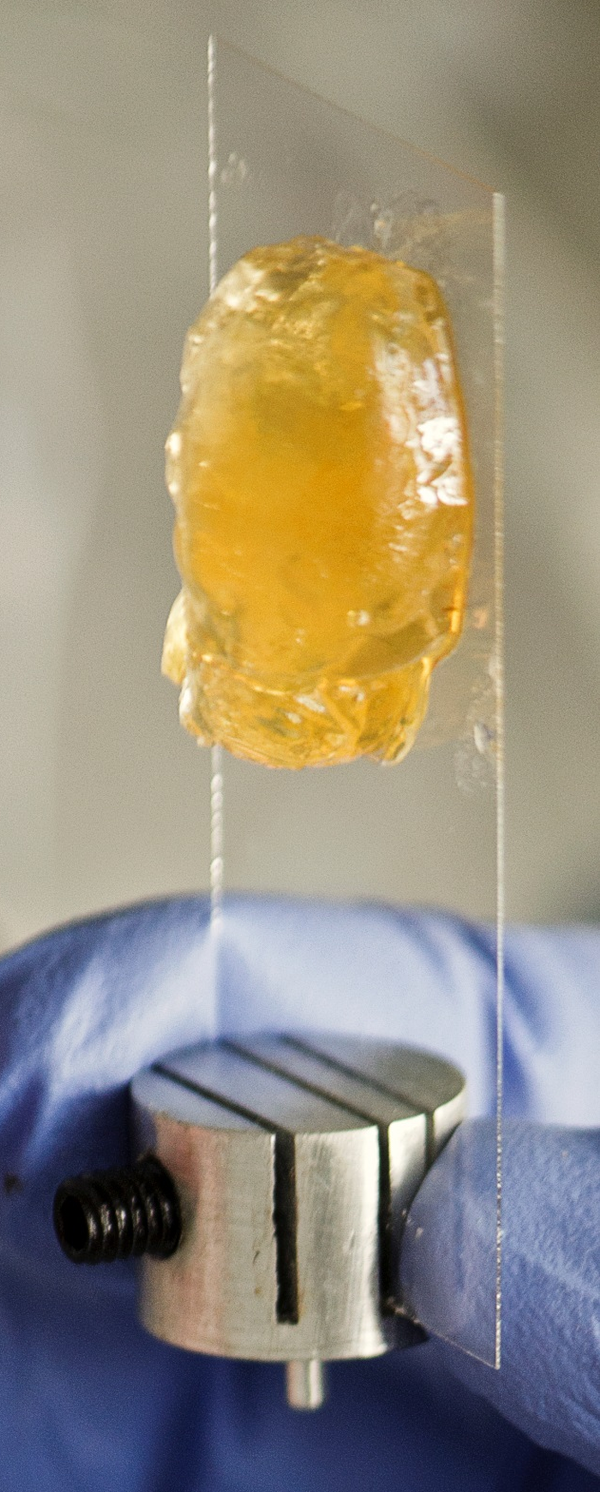
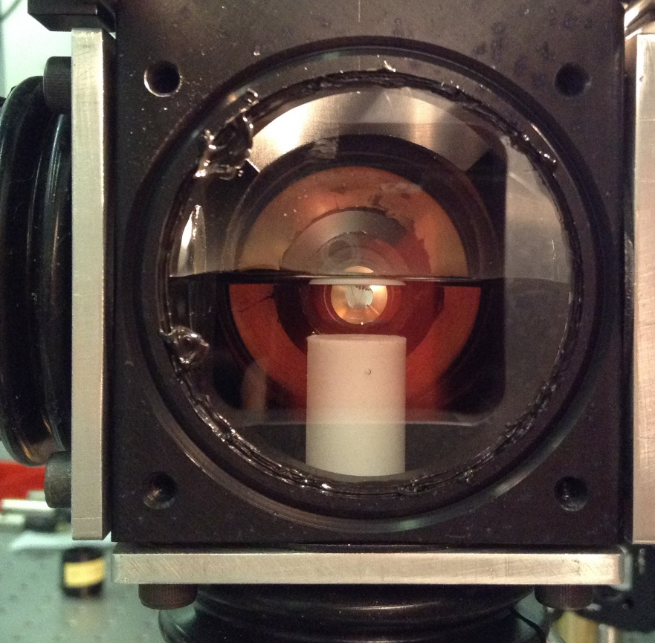
z
A
B
D
E
x
C

Slide 9
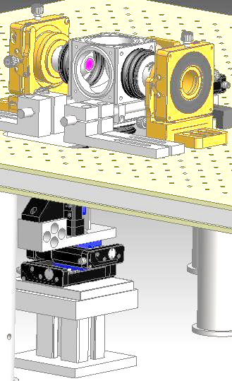
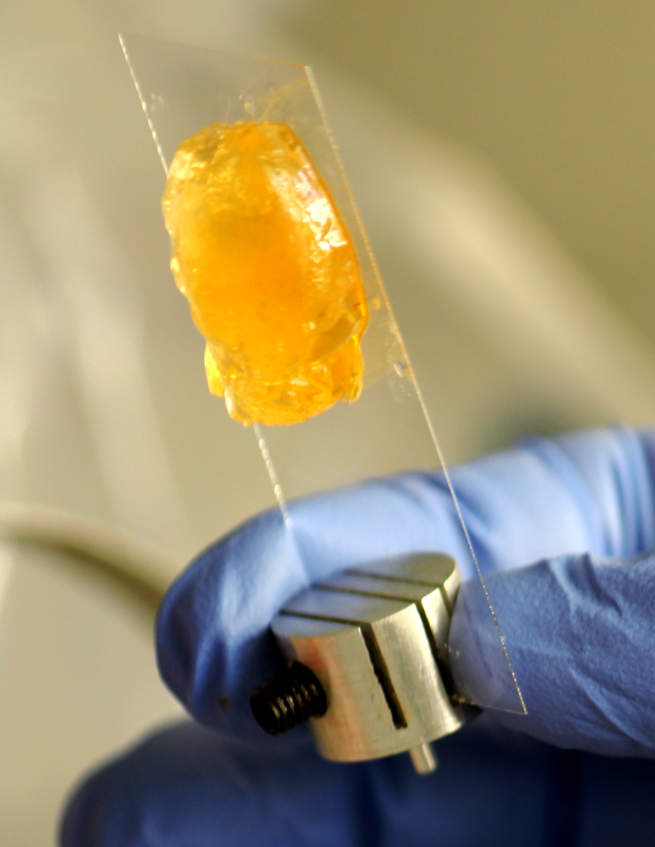
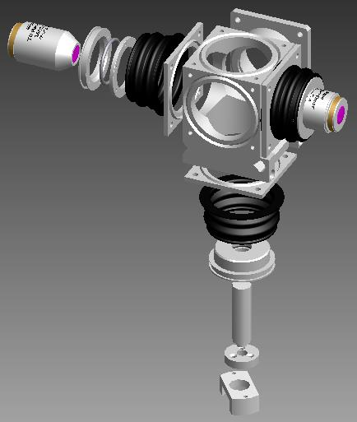

Slide 10
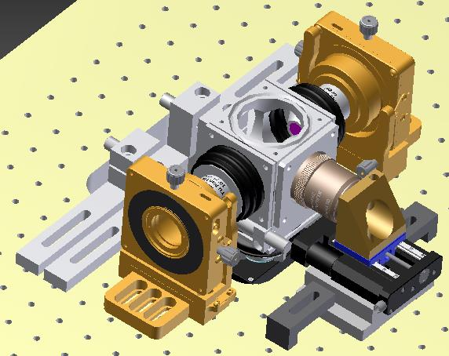
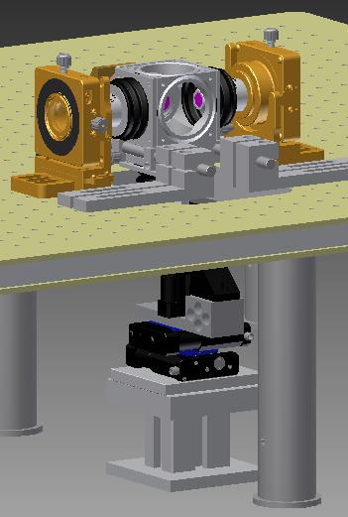
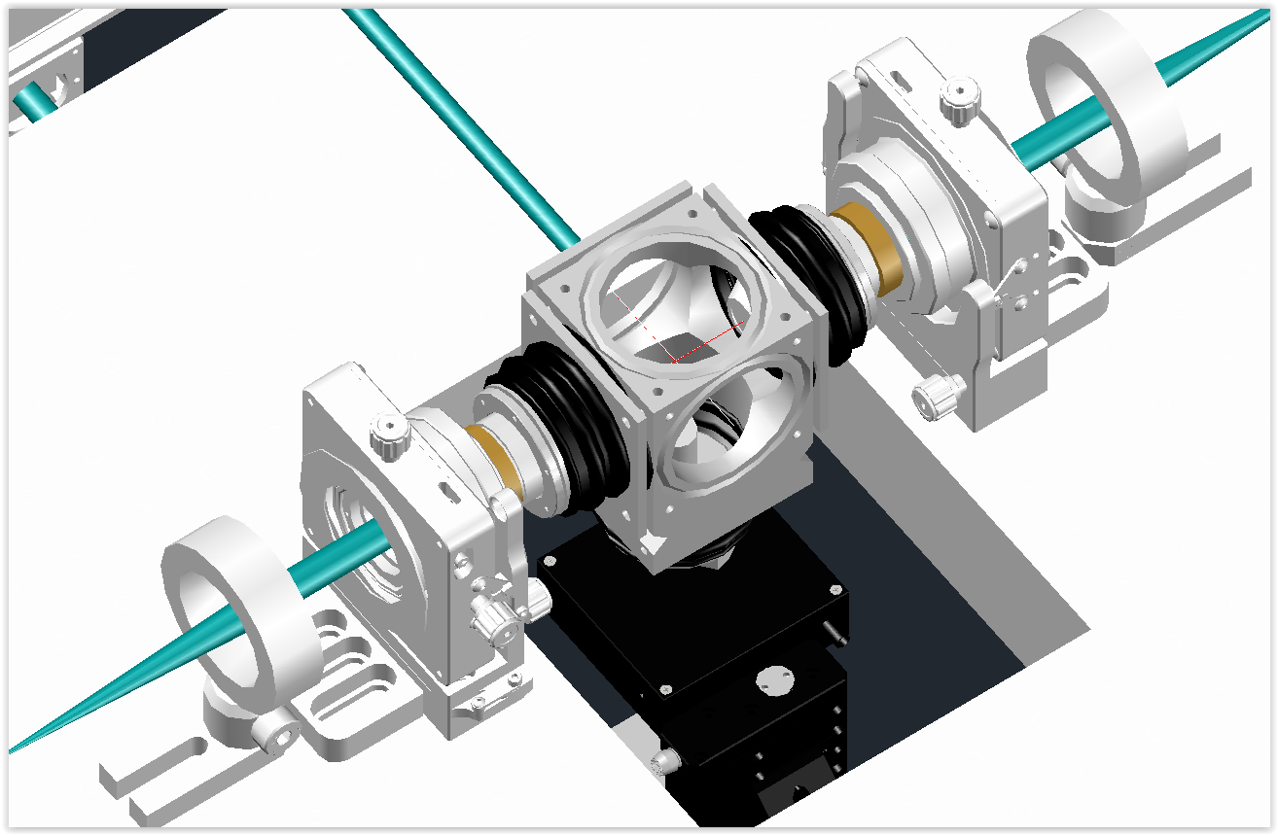

Slide 11
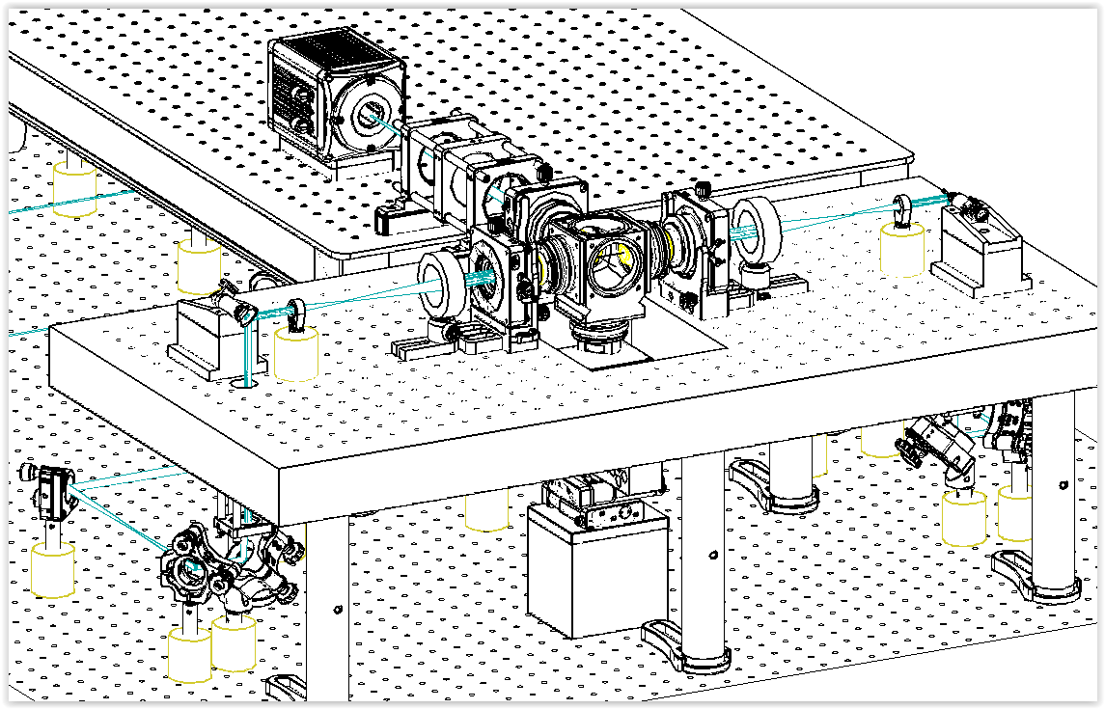

Slide 12
Camera
f 100
f 200
Olympus XLSLPLN25XGMP
25×, 1.0NA
WD: 8mm
f 100
DMM
f 80
f 300

Slide 13
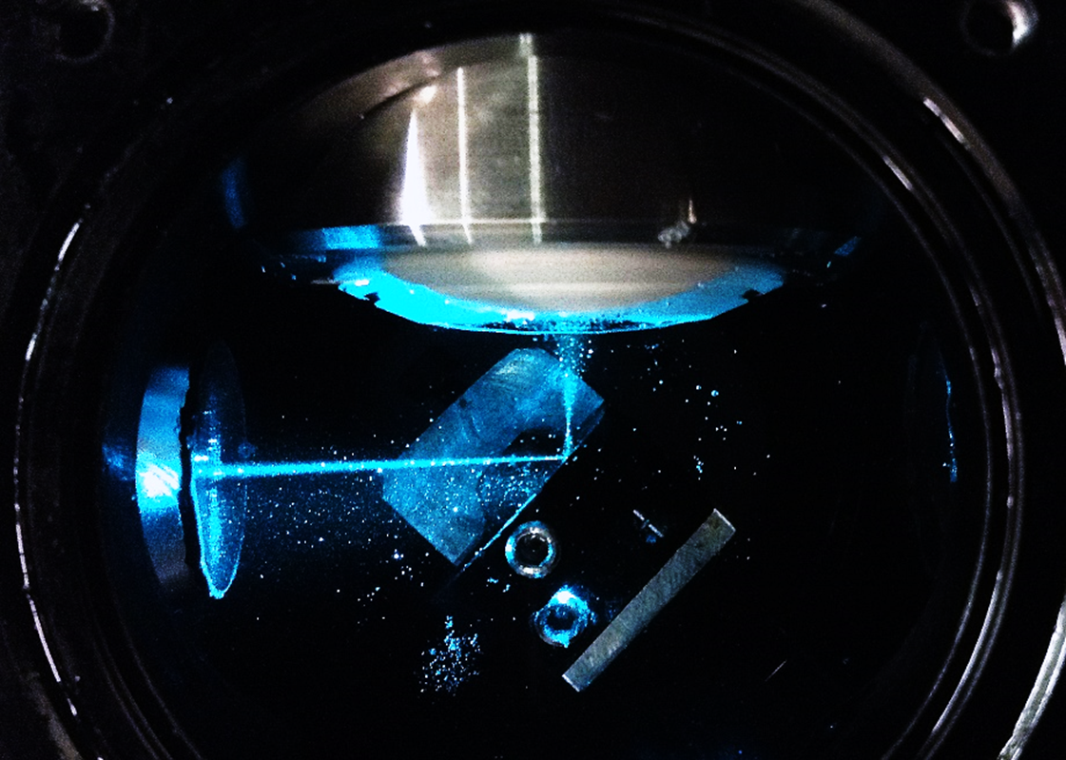
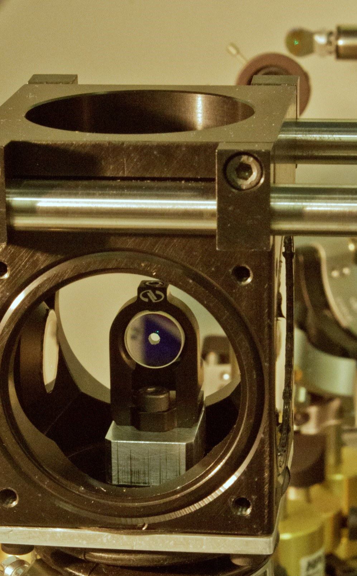
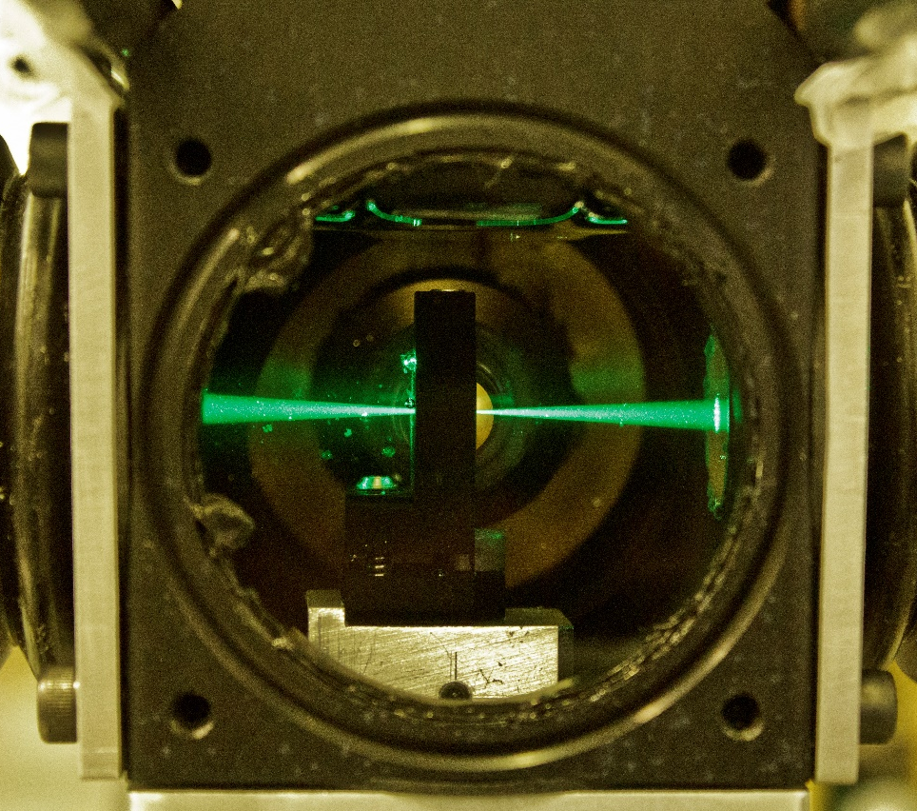
A
Camera
B
D
PBS
AD 350
AD 350
AD 200
AD 200
AD 200
C
v
AD 50
AD 100
AD 100
AD 50

Slide 14
Camera
1’ image plane
PBS
AD 350
AD 350
AD 200
AD 200
AD 200
1’ image plane
BFP
1’ image plane
BFP
BFP
galvo
v
galvo
AD 50
AD 100
AD 100
AD 50
object
plane
4f
4f

Slide 15
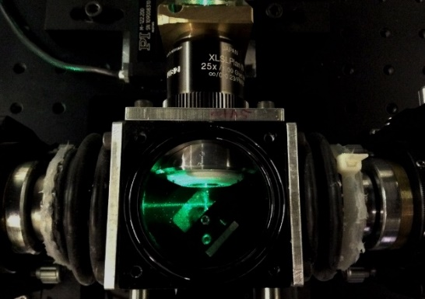

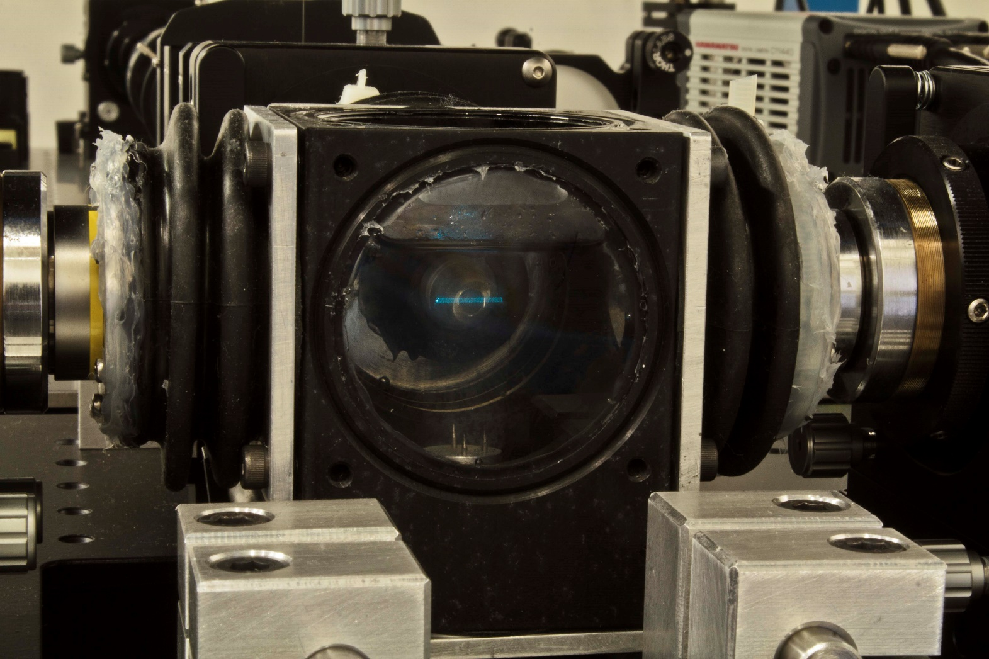
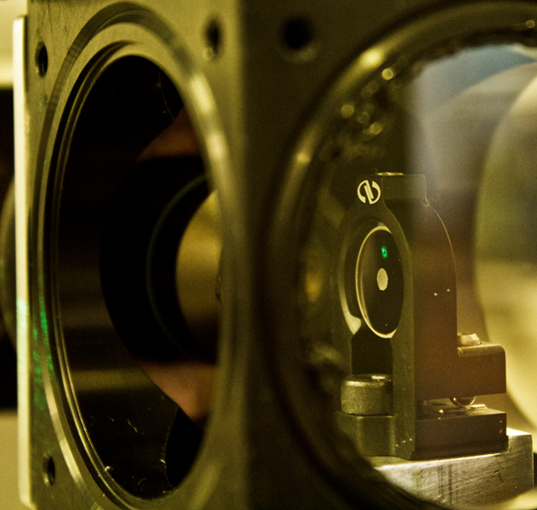

Slide 16
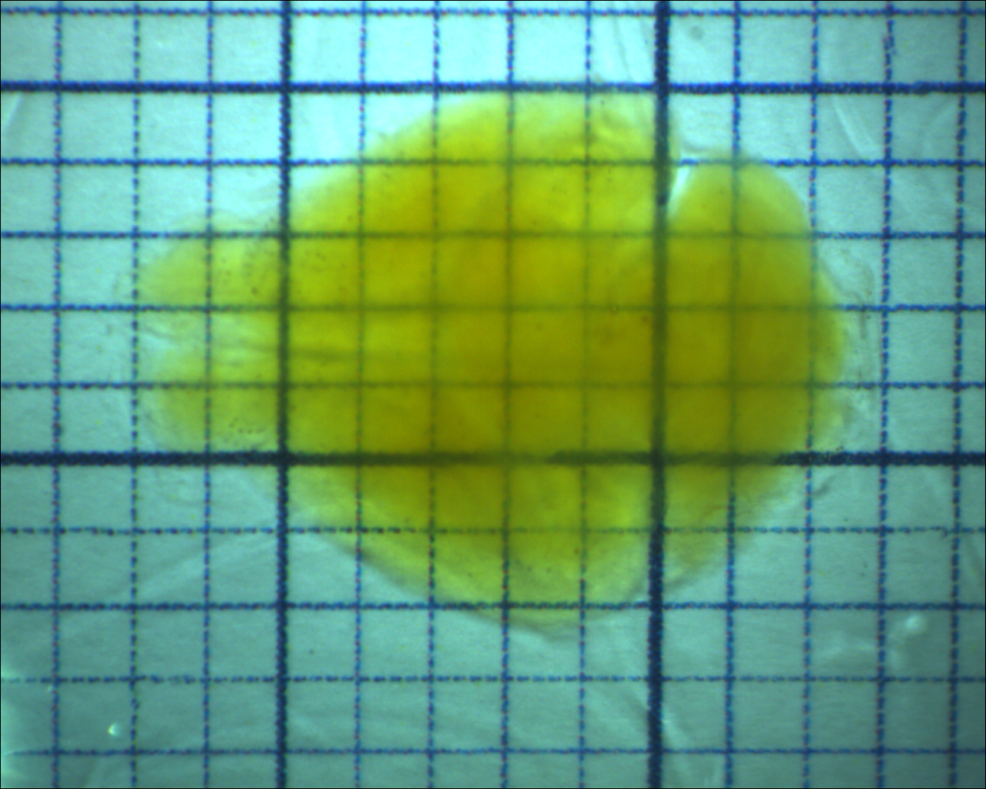

Slide 17
A
B
Tomo
Motor stages
USB
X
Y
Z
θ
Stack
Data Transfer
Laser
PC 1
Laser
RS232 Hub
Laser
Laser
AOTF
Laser
Camera
Motor Stages
USB
Galvo A
DAQ
Galvo B
BNC AO
Waveform
Generator
AOTF
(Shutter)
Custom Eletronics
Pulse
Amp.
Laser
Mod.
Int. BUS
BNC AO & DO
PC 2
Trigger pulses
DAQ
Board
Camera
CameraLink
Laser
Modulator
Galvo
Scanners
Lasers

Slide 18
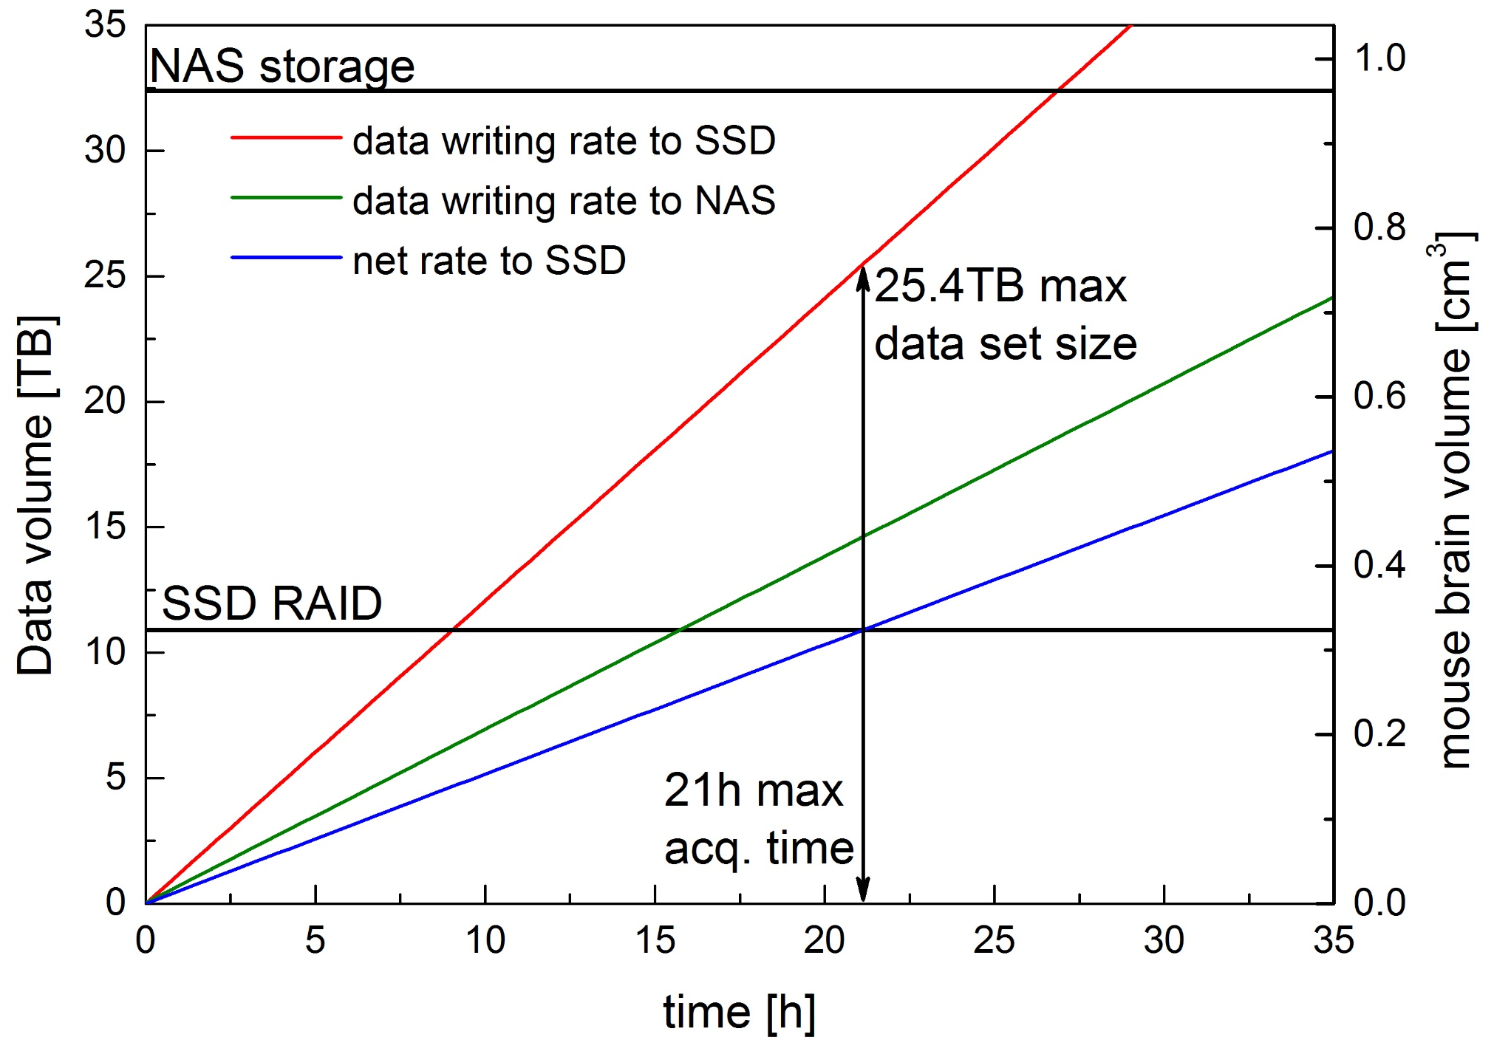
A
B
Camera
10 Gb Optical fibre
Supercomputing Centre
Bologna
CameraLink
board
10Gb network card
System
bus
Network-attached storage
32.4 TB
Data stream saving
Local SSD RAID 0
10.9TB
Data stream moving
Python script
Workstation
Laboratory

Slide 19
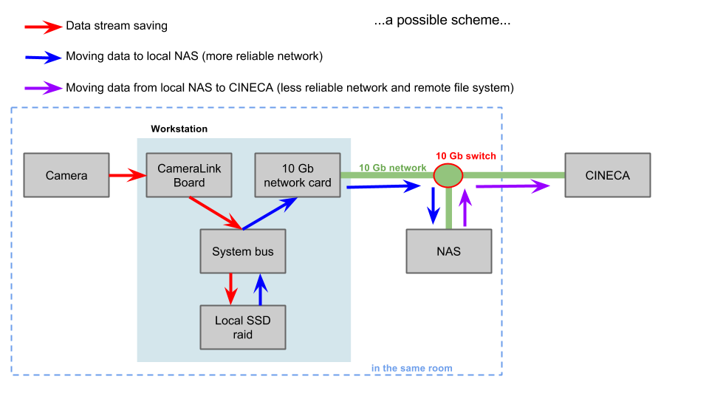
Data management
Python script from collaborators in Rome:
digitally downsample our images
transfer from SSD to NAS
Convert from .xcd to .tif
→ decrease of size by factor 10
32.4TB
10.9TB

Slide 20
Tomo
Stack
Data transfer
aquire image sweep:
# of frames
file name
Camera
move:
speed
step
SPIM imaging
AOTF
PI stages
Laser
DM mirror
cameralink
DAQmx
serial
USB
serial
Pockels cell
Galvos
Camera
AOTF
stages
Laser
DM mirror

Slide 21
Tomo
Stack
Data Transfer
Camera
Motor Stages
Waveform
Generator
AOTF
(Shutter)
DAQ
Board
Laser
Modulator
Galvo
Scanners
Lasers

Slide 23
AD f=100
AD f=100
AD f=50

Slide 25
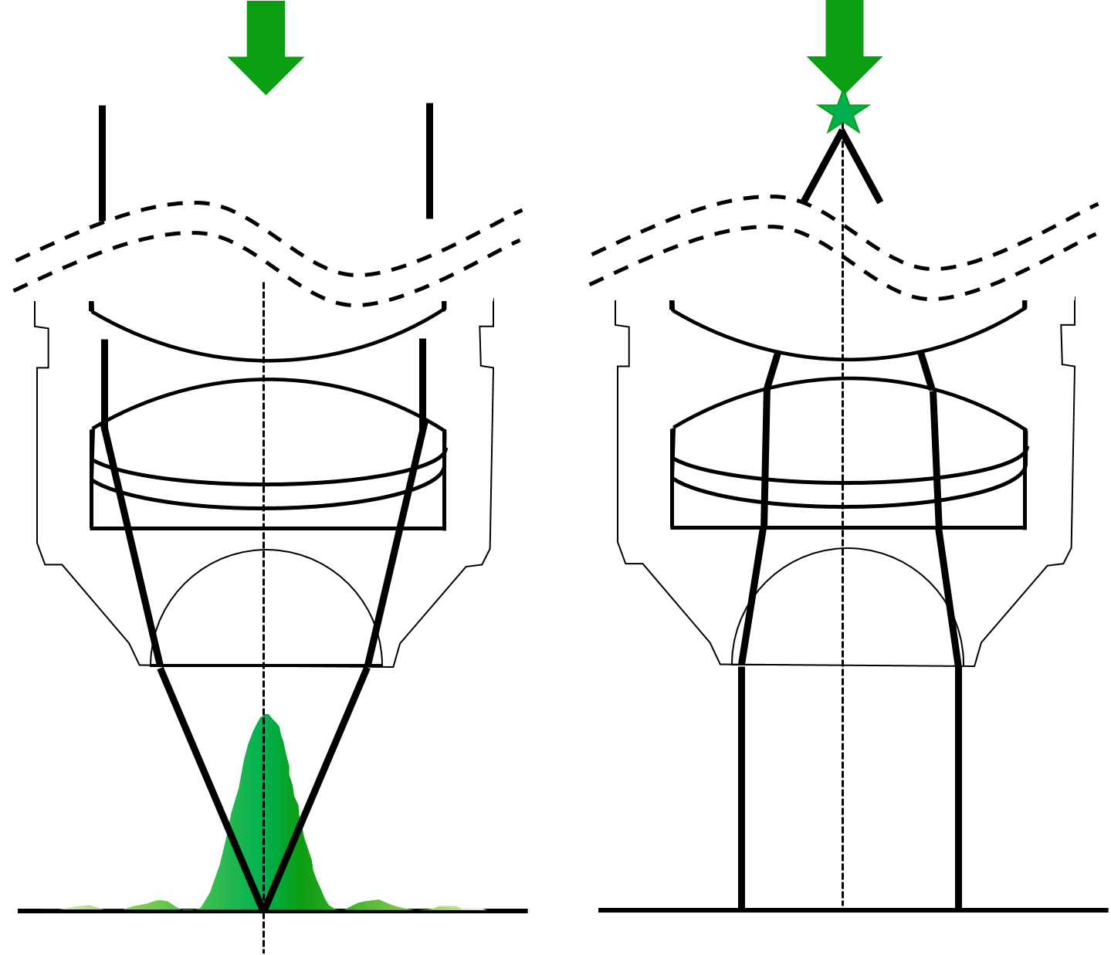
A
B
C
D
AD f=100
AD f=100
AD f=50

